Slide 1
CEGE0004: Machine Learning for Data Science Lecture 8: Reinforcement Learning Dr. Aldo Lipani

Slide 2
Introduction
How an autonomous agent that senses and acts in its environment can learn to choose optimal actions to achieve its goals?
Each time the agent performs an action in its environment a trainer may provide a reward or penalty to indicate the desirability of the resulting state.
A positive reward when the game is won;
A negative reward when it is lost, or
Nothing in all other states.
The task of the agent is to learn from this indirect delayed reward, to choose sequences of actions that produce the greatest cumulative reward.

Slide 3
Reinforcement Learning
Reinforcement Learning
Reward System
Classical/Operant Conditioning
Bounded Rationality
Operations Research
Optimal Control
Machine Learning
Computer Science
Engineering
Neuroscience
Psychology
Economics
Mathematics
Machine Learning
Supervised Learning
Unsupervised Learning
Reinforcement Learning

Slide 4

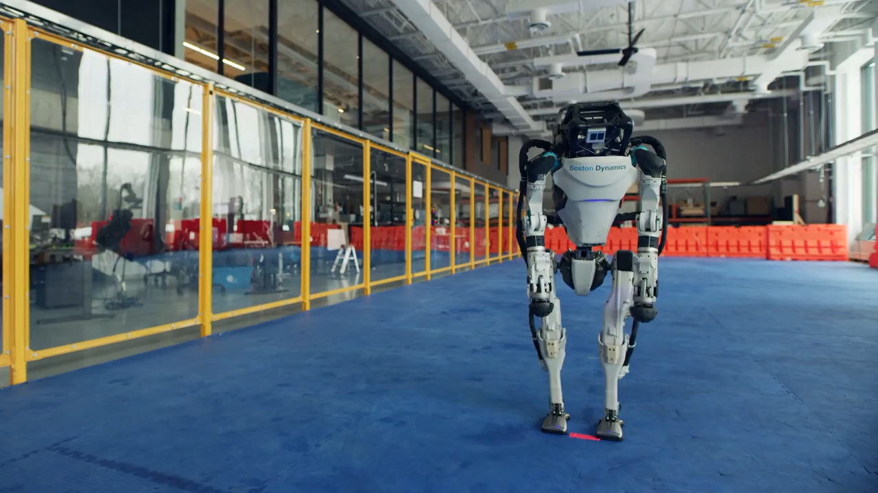
Applications of RL
Learning to control a mobile robot.
https://www.youtube.com/watch?v=VMp6pq6_QjI
https://www.youtube.com/watch?v=fn3KWM1kuAw

Slide 5
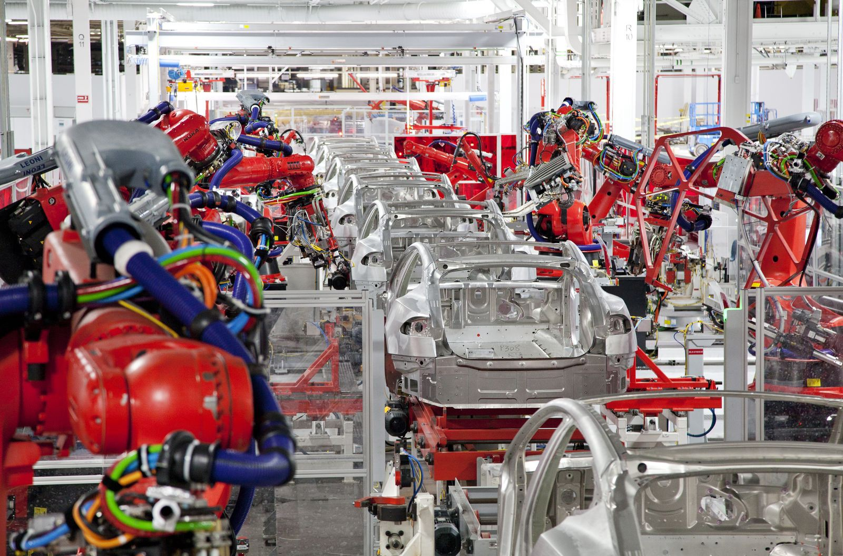
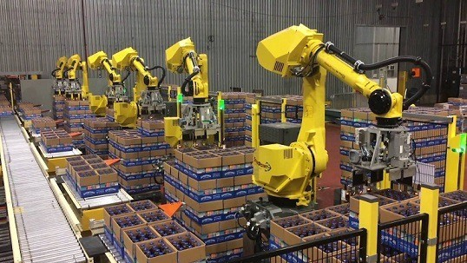
Applications of RL
Learning to optimize operations in factories.

Slide 6
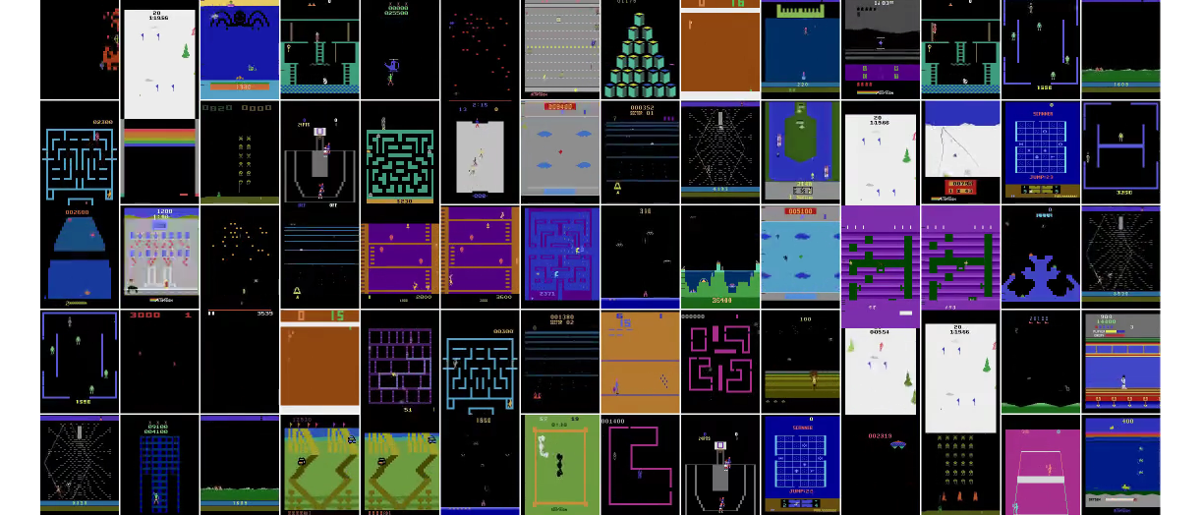
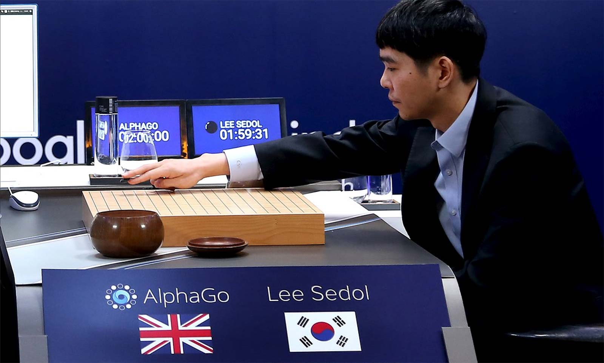
Applications of RL
Learning to boardgames and arcade games.

Slide 7
An RL Task
Let's build a robot/agent with sensors such as a camera and a sonar and able to perform actions such as move forward and turn.
Its task is to learn a policy for choosing actions to achieve its goal.
For example, the robot may have a goal of docking onto its battery charger whenever its battery level is low.
How can such agents learn successful control policies by experimenting in their environment?
We assume that the goals of the agent can be defined by a reward function that assigns a numerical value (an immediate payoff) to each distinct action the agent may take from each distinct state.
The task of the robot is to perform sequences of actions, observe their consequences, and learn a control policy: from any state it chooses actions that maximize the reward accumulated over time by the agent.

Slide 8
The RL Problem
To learn a control policy to maximize cumulative reward is very general and covers many problems beyond robot learning tasks.
We want to learn to control a sequential process:
manufacturing optimization problems in which a sequence of manufacturing actions must be chosen; Reward to be maximized is the value of goods produced minus the costs involved.
sequential scheduling problems such as choosing which taxi to send for passengers in a large city, where the reward to be maximized is a function of the wait time of the passengers and the total fuel costs of the taxi fleet.
We are interested in any type of agent that must learn to choose actions that alter the state of its environment and where a cumulative reward function is used.

Slide 9

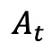
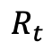
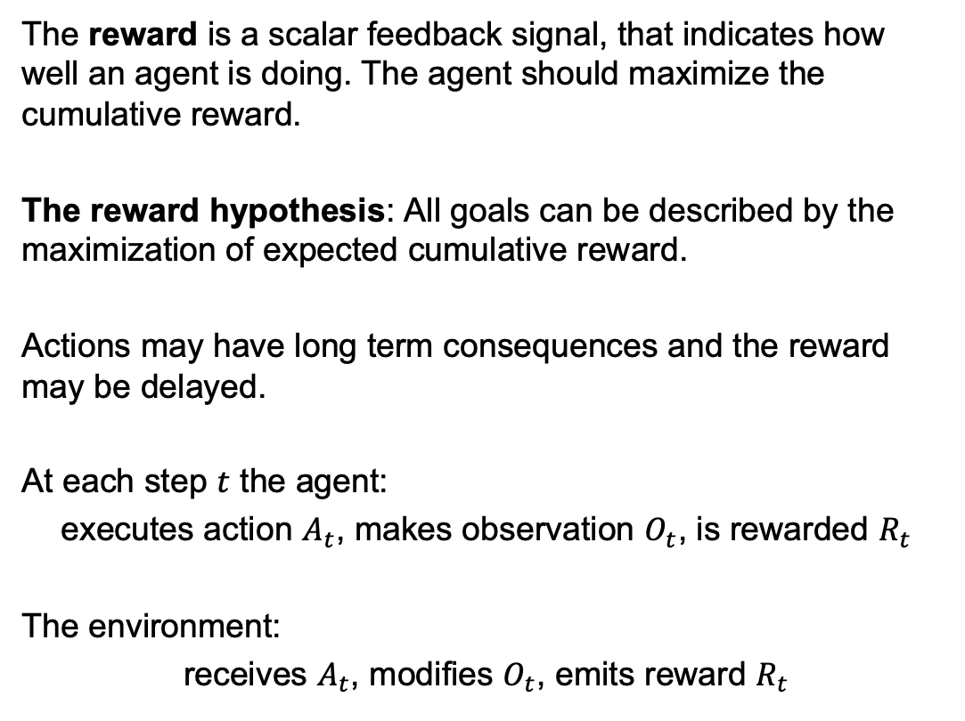
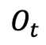
Key Concepts
The reward is a scalar feedback signal, that indicates how well an agent is doing. The agent should maximize the cumulative reward.
The reward hypothesis: All goals can be described by the maximization of expected cumulative reward.
Actions may have long term consequences and the reward may be delayed.
At each step $t$ the agent:
executes action $A_{t}$, makes observation $O_{t}$, is rewarded $R_{t}$
The environment:
receives $A_{t}$, modifies $O_{t}$, emits reward $R_{t}$
$$O_{t}$$
$$R_{t}$$
$$A_{t}$$

Slide 10
Components of an RL Agent
An RL agent may include one or more than one of these 3 components:
Policy
This defines the agent's behavior function. It maps states to actions.
Value Function
It evaluates how good each state and action is by predicting future rewards.
Model
The agent representation of the environment. It predicts how the environment will respond.

Slide 11

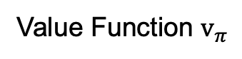
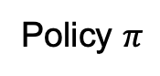
A Maze Example
Maze
The figure represents a maze. The goals for the agent is to go from the green square to the red square:
Reward: -1 per time-step.
Actions: N, E, S, W
States: Agent's location
Policy $π$
Value Function $v_{π}$
Model
-9 | -8 | -7 | -6 | -7
 | -9 |  | -5
 | -10 |  | -4 | -3
 | -11 |  |  | -2 | -1
-1 | -1 | -1 | -1 | -1
 |  |  | -1
 |  |  | -1 | -1
 |  |  |  | -1 | -1

Slide 12
Categorizing RL Agents
Each RL method can be catharized into:
Value Based
No Policy (Implicit)
Value Function
Policy Based
Policy
No Value Function
Actor Critic
Policy
Value Function
Model Free
Policy and/or Value Function
No Model
Model Based
Policy and/or Value Function
Model

Slide 13
Learning vs Planning
There are two fundamental problems in sequential decision making.
Learning:
the environment is initially unknown;
the agent interacts with the environment;
the agent improves its policy.
Planning:
a model of the environment is known;
the agent performs computations with its model (without any external interaction);
the agent improves its policy by searching.

Slide 14
Class of RL Problems
Deterministic or nondeterministic outcomes.
When deterministic agents have prior knowledge about the effects of its actions on the environment. Not, when nondeterministic.
Usually, actions may have nondeterministic outcomes, and the agent lacks a domain theory that describes outcomes of its actions.

Slide 15
RL Methods
Tabular Solution Methods
Multi-Arm Bandits
Markov Decision Processes
Dynamic Programming
Monte Carlo Methods
Temporal-Difference Learning
Approximate Solution Methods
Approximation of Action Values
Policy Approximation

Slide 16
Exploitation and Exploitation
Reinforcement learning is like trial-and-error learning:
the agent should discover a good policy from its experiences of the environment without losing too much reward along the way.
This search is a trade-off between exploitation and exploration:
When exploring the agent aims to gather more information about the environment;
When exploiting the agent exploits known information to maximise reward.
It is usually important to explore as well as exploit.
Do you always go to the same restaurant or you try new ones?

Slide 17
Q-Learning

Slide 18
Introduction
We will focus on Q-Learning.
This acquires an optimal control strategy from delayed rewards, even when the agent has no prior knowledge of the effects of its actions on the environment.
Reinforcement learning algorithms are related to dynamic programming algorithms or Viterbi algorithms used to solve optimization problems.

Slide 19
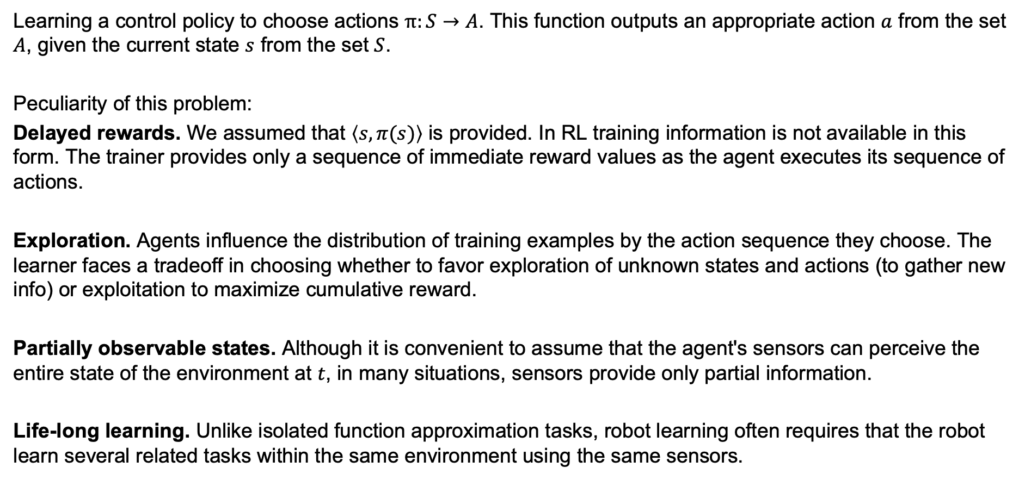
Learning a Control Policy
Learning a control policy to choose actions $π:S→A$. This function outputs an appropriate action $a$ from the set $A$, given the current state $s$ from the set $S$.
Peculiarity of this problem:
Delayed rewards. We assumed that $\left\langle s, π(s)\right\rangle$ is provided. In RL training information is not available in this form. The trainer provides only a sequence of immediate reward values as the agent executes its sequence of actions.
Exploration. Agents influence the distribution of training examples by the action sequence they choose. The learner faces a tradeoff in choosing whether to favor exploration of unknown states and actions (to gather new info) or exploitation to maximize cumulative reward.
Partially observable states. Although it is convenient to assume that the agent's sensors can perceive the entire state of the environment at $t$, in many situations, sensors provide only partial information.
Life-long learning. Unlike isolated function approximation tasks, robot learning often requires that the robot learn several related tasks within the same environment using the same sensors.

Slide 20
The Learning Task
Learning sequential control strategies:
Is it deterministic nondeterministic?
Can the agent predict the next state?
Is the agent trained by an expert?
We will define a general formulation of the problem based on Markov Decision Processes (MDP).

Slide 21
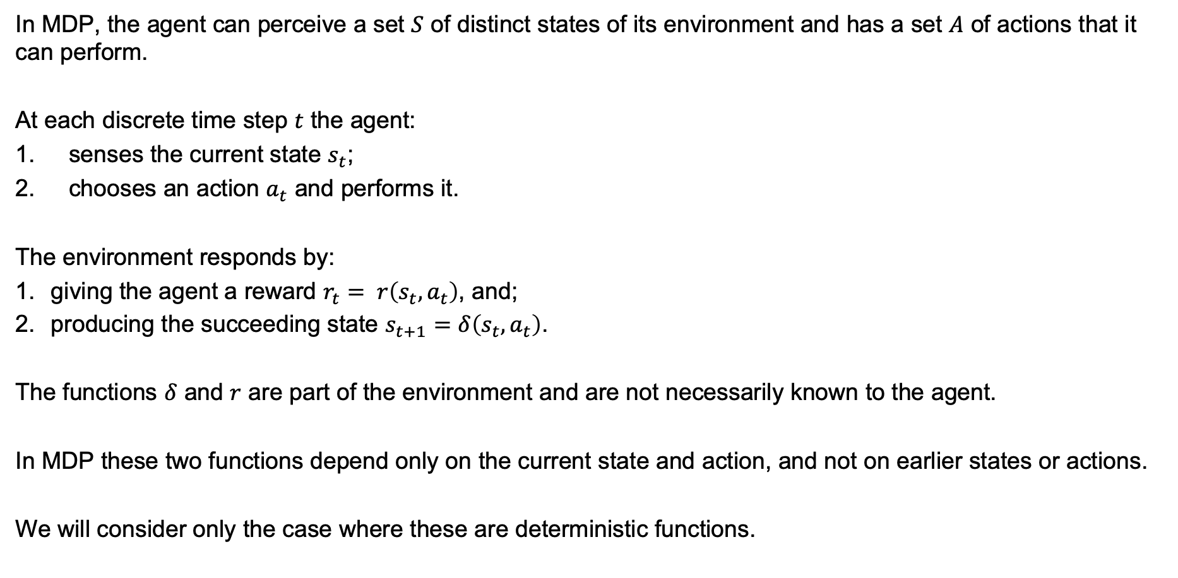
Markov Decision Process (MDP)
In MDP, the agent can perceive a set $S$ of distinct states of its environment and has a set $A$ of actions that it can perform.
At each discrete time step $t$ the agent:
senses the current state $s_{t}$;
chooses an action $a_{t}$ and performs it.
The environment responds by:
giving the agent a reward $r_{t}= r\left(s_{t}, a_{t}\right)$, and;
producing the succeeding state $s_{t+1}=δ\left(s_{t}, a_{t}\right)$.
The functions $δ$ and $r$ are part of the environment and are not necessarily known to the agent.
In MDP these two functions depend only on the current state and action, and not on earlier states or actions.
We will consider only the case where these are deterministic functions.

Slide 22
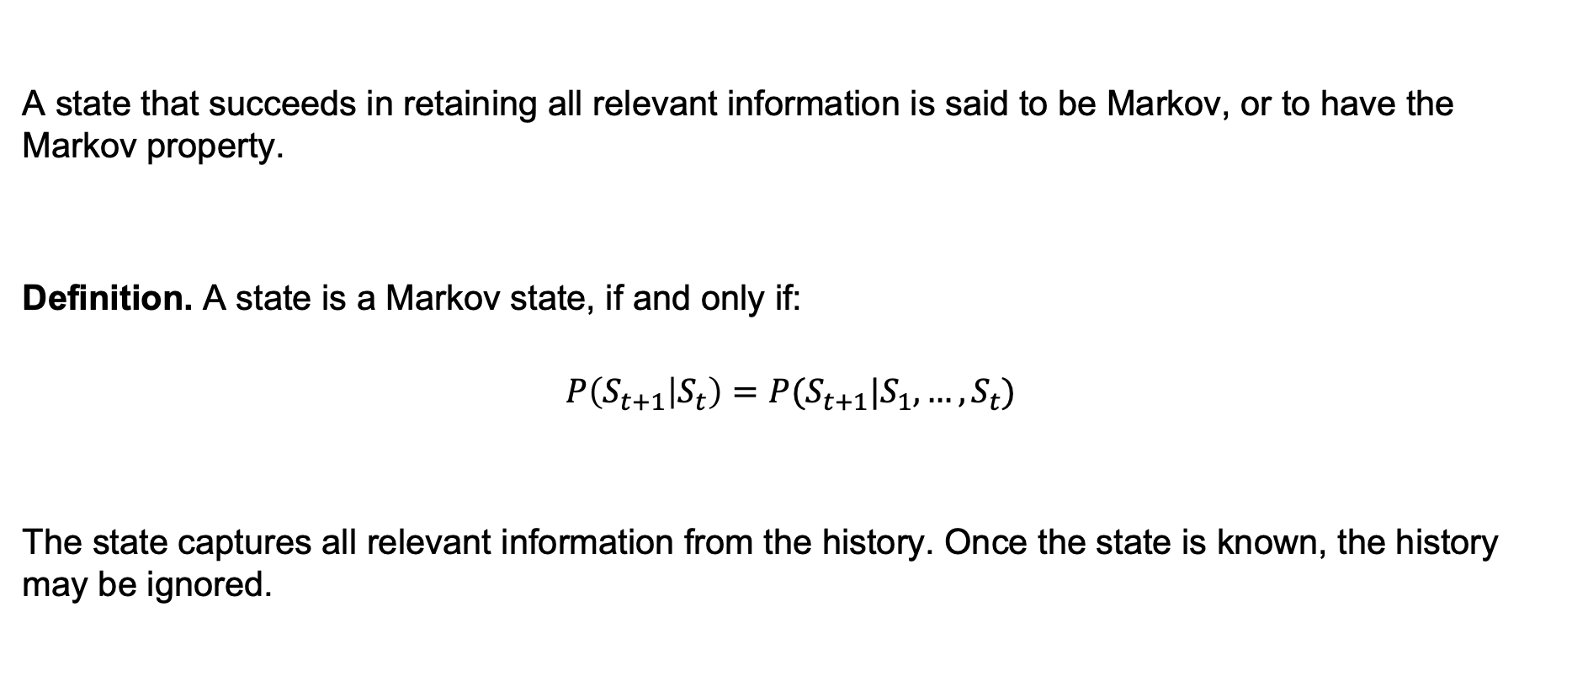
Markov State
A state that succeeds in retaining all relevant information is said to be Markov, or to have the Markov property.
Definition. A state is a Markov state, if and only if:
$$P\left(S_{t+1} | S_{t}\right)=P(S_{t+1}|S_{1},…,S_{t})$$
The state captures all relevant information from the history. Once the state is known, the history may be ignored.

Slide 23
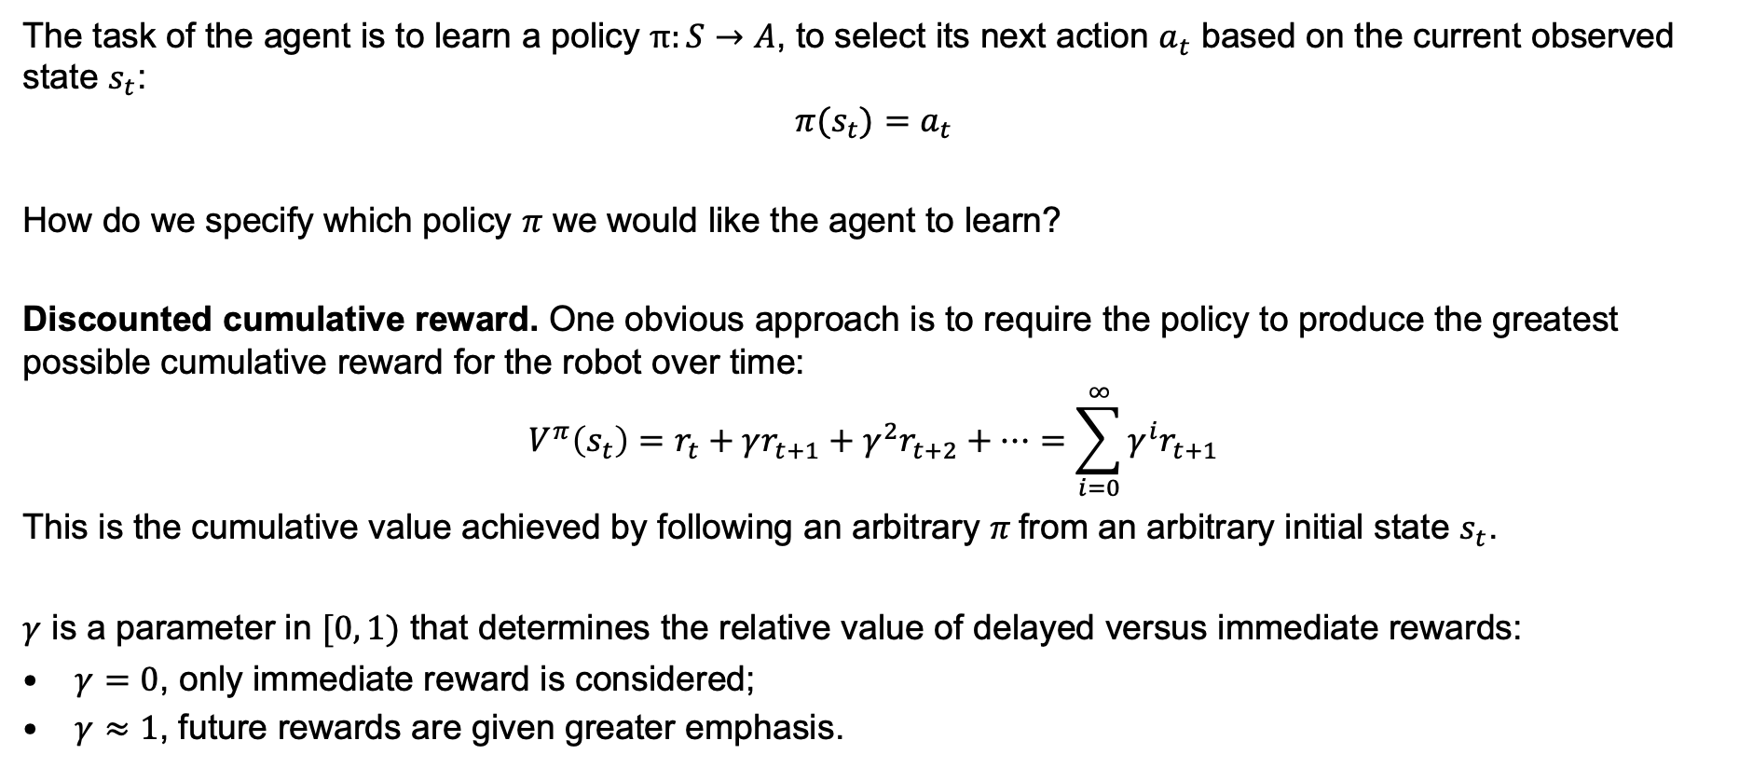
Discounted Cumulative Reward
The task of the agent is to learn a policy $π:S→A$, to select its next action $a_{t}$ based on the current observed state $s_{t}$:
$$π(s_{t})=a_{t}$$
How do we specify which policy $π$ we would like the agent to learn?
Discounted cumulative reward. One obvious approach is to require the policy to produce the greatest possible cumulative reward for the robot over time:
$$V^{π}\left(s_{t}\right)=r_{t}+γr_{t+1}+γ^{2}r_{t+2}+…=\sum_{i=0}^{∞}{γ^{i}r_{t+1}}$$
This is the cumulative value achieved by following an arbitrary $π$from an arbitrary initial state $s_{t}$.
$γ$ is a parameter in $[0, 1)$ that determines the relative value of delayed versus immediate rewards:
$γ=0$, only immediate reward is considered;
$γ≈1$, future rewards are given greater emphasis.

Slide 24
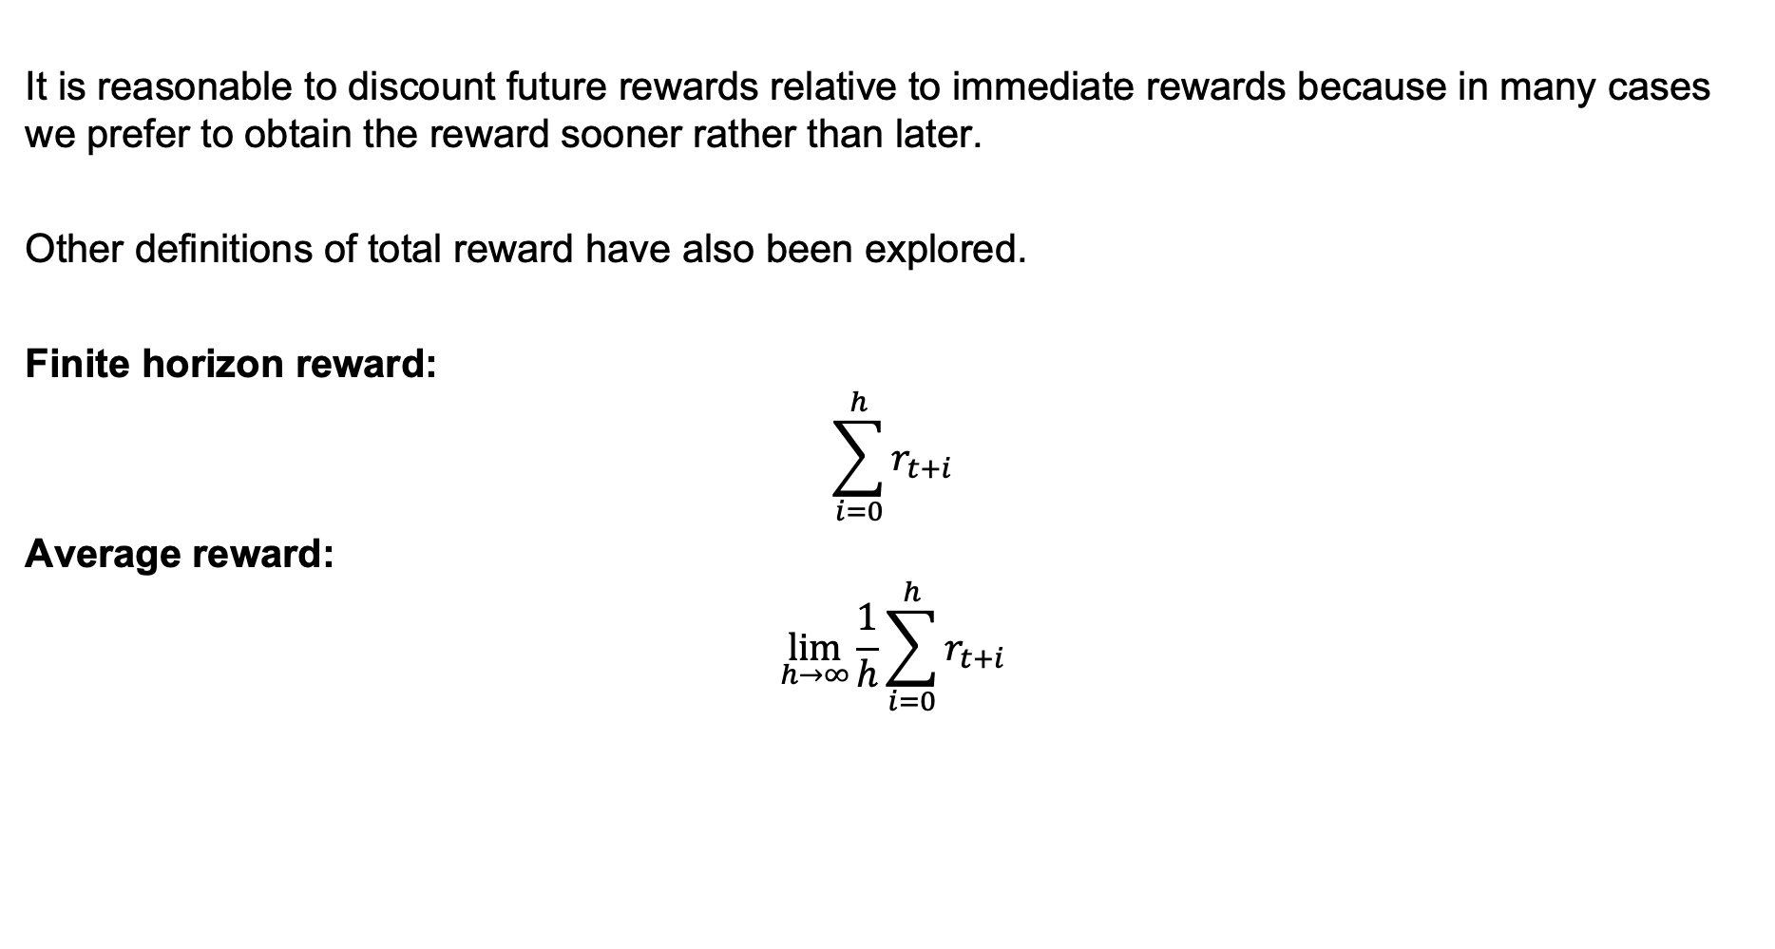
Other Cumulative Reward Functions
It is reasonable to discount future rewards relative to immediate rewards because in many cases we prefer to obtain the reward sooner rather than later.
Other definitions of total reward have also been explored.
Finite horizon reward:
$$\sum_{i=0}^{h}{r_{t+i}}$$
Average reward:
$$\lim_{h→∞}{\frac{1}{h}\sum_{i=0}^{h}{r_{t+i}}}$$

Slide 25
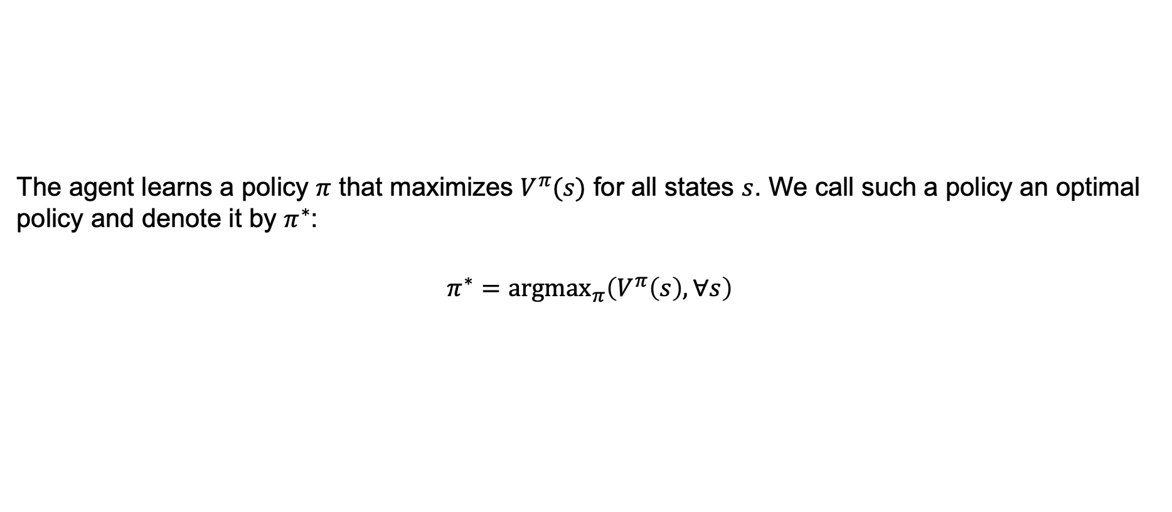
The Optimal Policy
The agent learns a policy $π$ that maximizes $V^{π}(s)$ for all states $s$. We call such a policy an optimal policy and denote it by $π^{∗}$:
$$π^{∗}={argmax}_{π}\left(V^{π}\left(s\right), ∀s\right)$$

Slide 26
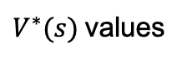
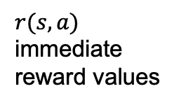
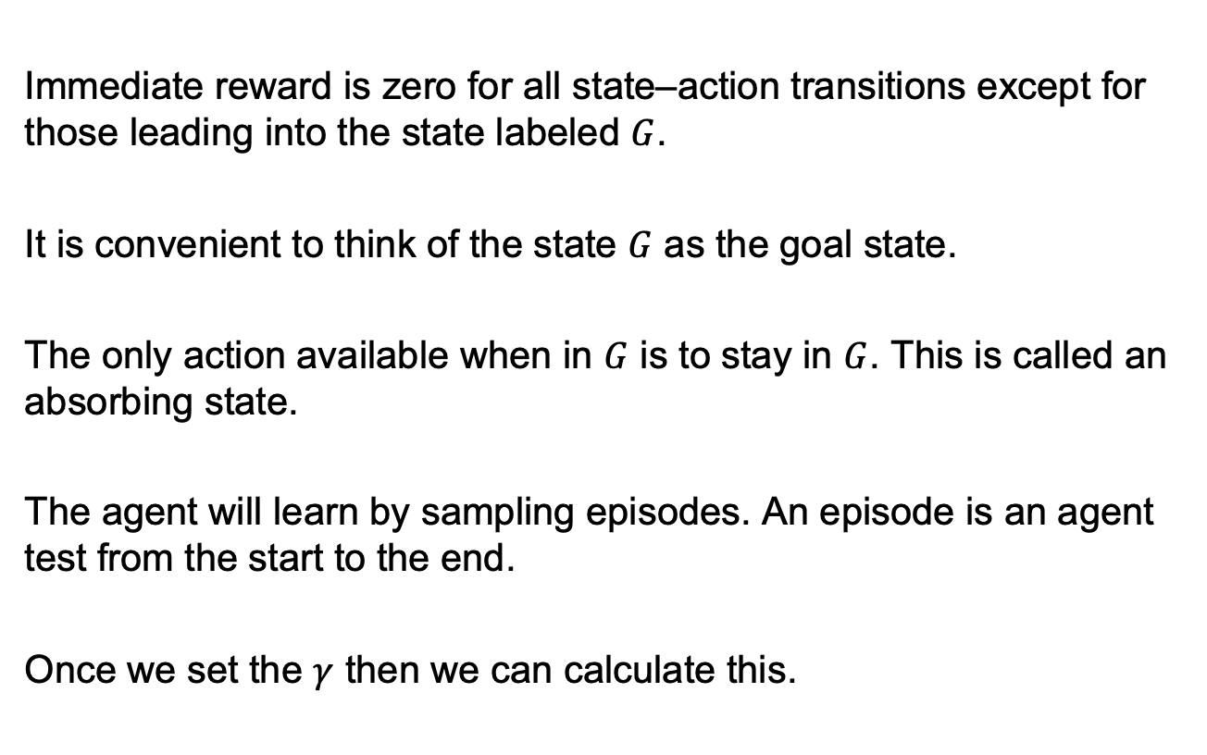
Grid-World Example
Immediate reward is zero for all state–action transitions except for those leading into the state labeled $G$.
It is convenient to think of the state $G$ as the goal state.
The only action available when in $G$ is to stay in $G$. This is called an absorbing state.
The agent will learn by sampling episodes. An episode is an agent test from the start to the end.
Once we set the $γ$ then we can calculate this.
$r(s,a)$ immediate reward values
$V^{∗}(s)$values
One optimal policy

Slide 27
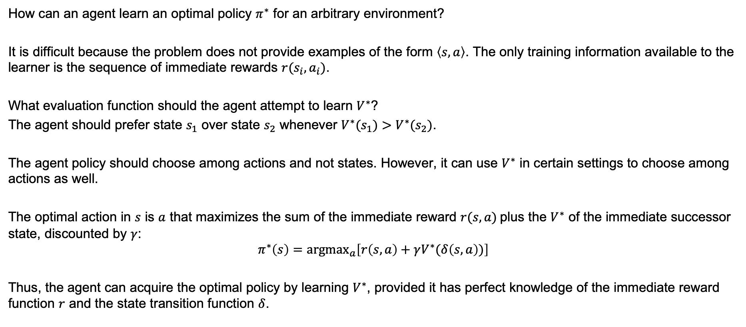
Finding the Optimal Policy
How can an agent learn an optimal policy $π^{∗}$ for an arbitrary environment?
It is difficult because the problem does not provide examples of the form $\left\langle s, a\right\rangle$. The only training information available to the learner is the sequence of immediate rewards $r(s_{i}, a_{i})$.
What evaluation function should the agent attempt to learn $V^{∗}$?
The agent should prefer state $s_{1}$ over state $s_{2}$ whenever $V^{∗}(s_{1})>V^{∗}(s_{2})$.
The agent policy should choose among actions and not states. However, it can use $V^{∗}$ in certain settings to choose among actions as well.
The optimal action in $s$ is $a$ that maximizes the sum of the immediate reward $r(s, a)$plus the $V^{∗}$ of the immediate successor state, discounted by $γ$:
$$π^{∗}\left(s\right)={argmax}_{a}\left[r\left(s, a\right)+γV^{∗}(δ\left(s, a\right))\right]$$
Thus, the agent can acquire the optimal policy by learning $V^{∗}$, provided it has perfect knowledge of the immediate reward function $r$ and the state transition function $δ$.

Slide 28
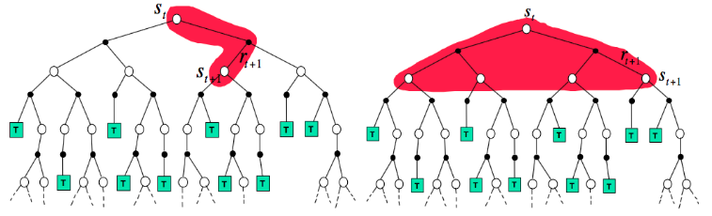
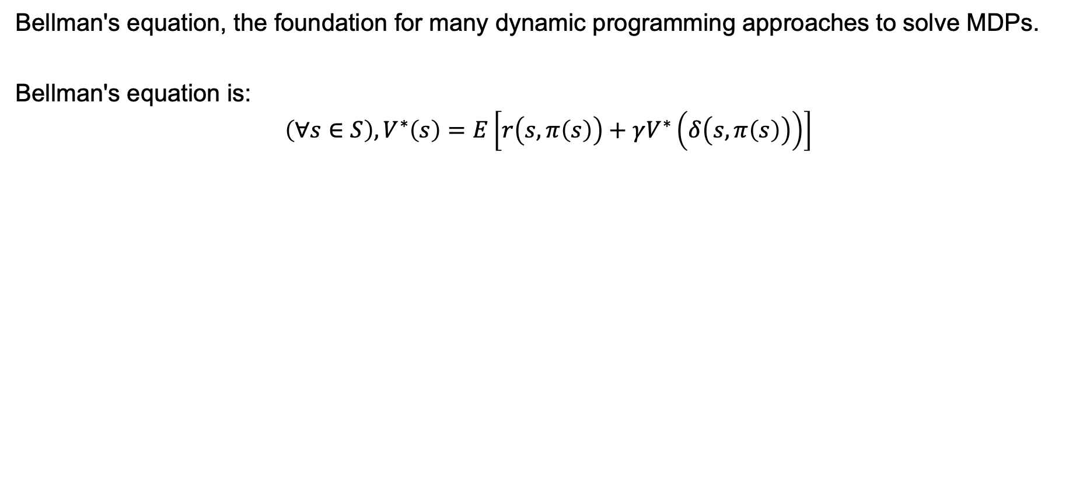
Dynamic Programming/Viterbi Algorithms
Bellman's equation, the foundation for many dynamic programming approaches to solve MDPs.
Bellman's equation is:
$$\left(∀s∈S\right), V^{∗}\left(s\right)=E\left[r\left(s,π\left(s\right)\right)+γV^{∗}\left(δ\left(s,π\left(s\right)\right)\right)\right]$$

Slide 29
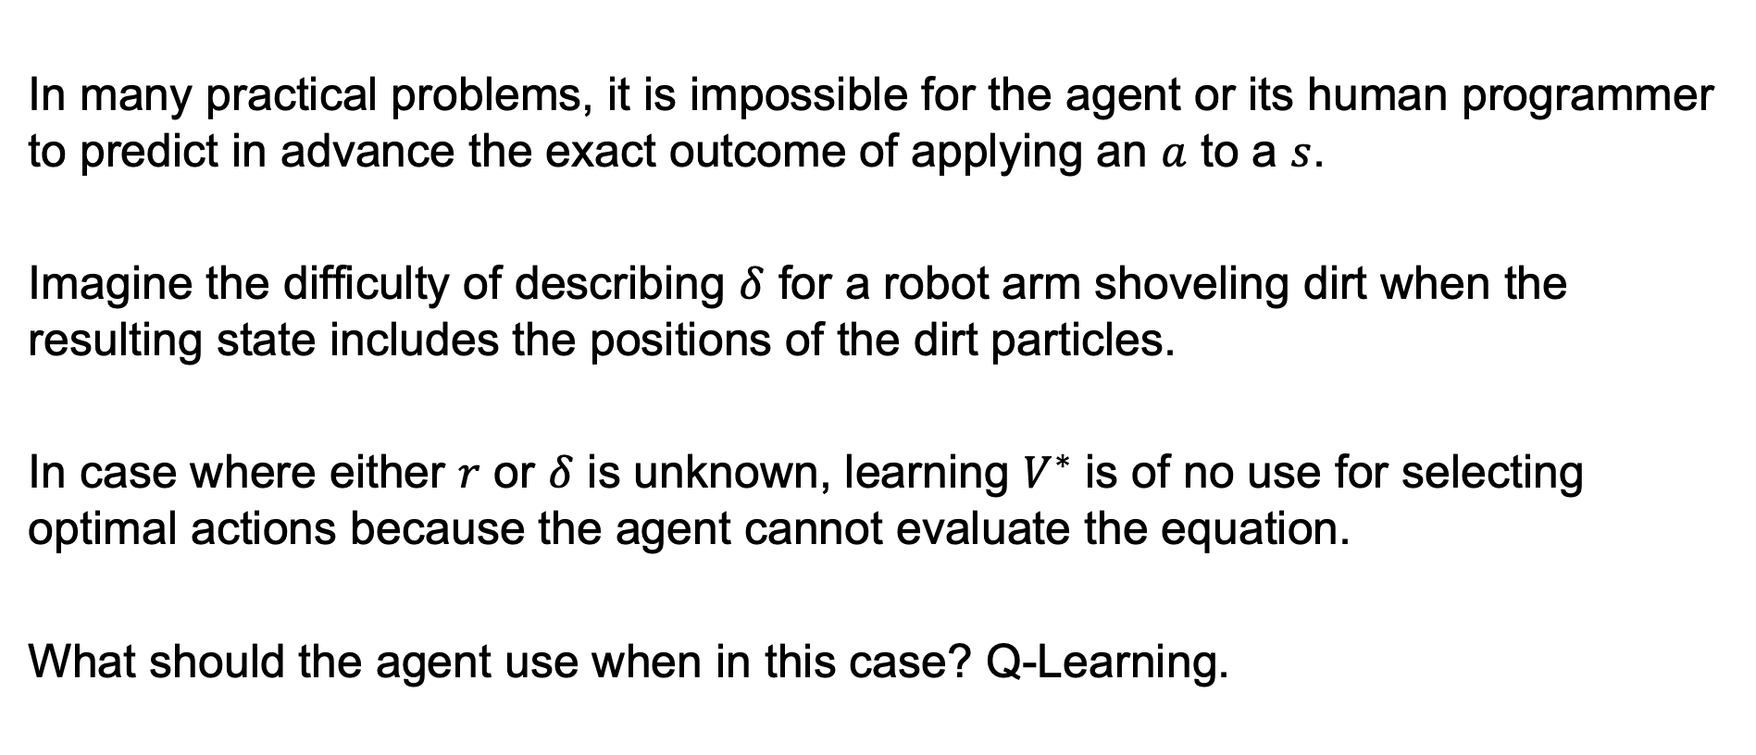
Limitations
In many practical problems, it is impossible for the agent or its human programmer to predict in advance the exact outcome of applying an $a$ to a $s$.
Imagine the difficulty of describing $δ$ for a robot arm shoveling dirt when the resulting state includes the positions of the dirt particles.
In case where either $r$ or $δ$ is unknown, learning $V^{∗}$ is of no use for selecting optimal actions because the agent cannot evaluate the equation.
What should the agent use when in this case? Q-Learning.

Slide 30
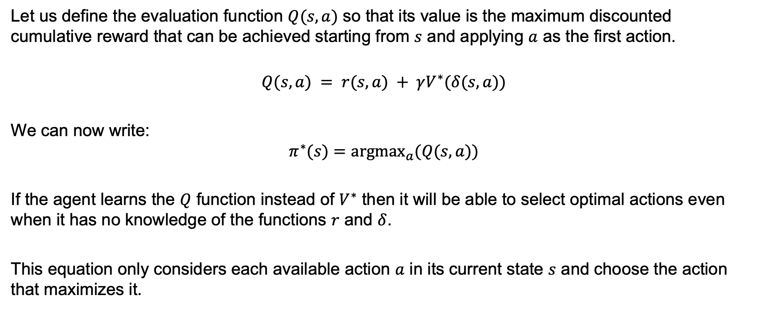
Q-Learning
Let us define the evaluation function $Q(s,a)$ so that its value is the maximum discounted cumulative reward that can be achieved starting from $s$ and applying $a$ as the first action.
$$Q(s, a) = r(s,a) + γV^{∗}(δ(s, a))$$
We can now write:
$$π^{∗}(s)={argmax}_{a}(Q(s,a))$$
If the agent learns the $Q$ function instead of $V^{∗}$ then it will be able to select optimal actions even when it has no knowledge of the functions $r$ and $δ$.
This equation only considers each available action $a$ in its current state $s$ and choose the action that maximizes it.

Slide 31
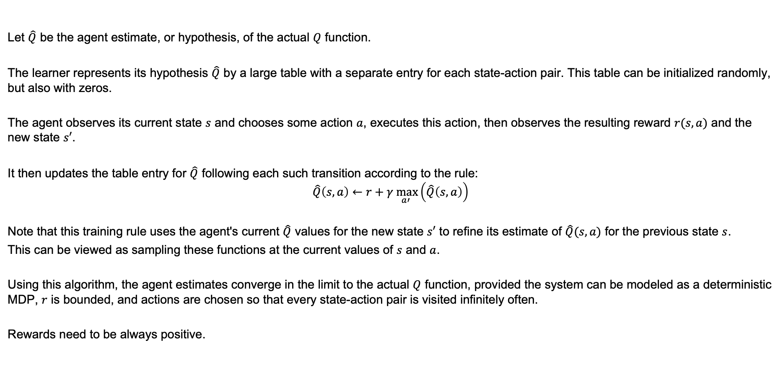
An Algorithm for Learning Q
Let $\hat{Q}$ be the agent estimate, or hypothesis, of the actual $Q$ function.
The learner represents its hypothesis $\hat{Q}$ by a large table with a separate entry for each state-action pair. This table can be initialized randomly, but also with zeros.
The agent observes its current state $s$ and chooses some action $a$, executes this action, then observes the resulting reward $r(s,a)$ and the new state $s′$.
It then updates the table entry for $\hat{Q}$ following each such transition according to the rule:
$$\hat{Q}\left(s,a\right)←r+γ\max_{a′}\left(\hat{Q}\left(s,a\right)\right)$$
Note that this training rule uses the agent's current $\hat{Q}$ values for the new state $s′$ to refine its estimate of $\hat{Q}(s,a)$ for the previous state $s$.
This can be viewed as sampling these functions at the current values of $s$ and $a$.
Using this algorithm, the agent estimates converge in the limit to the actual $Q$ function, provided the system can be modeled as a deterministic MDP, $r$ is bounded, and actions are chosen so that every state-action pair is visited infinitely often.
Rewards need to be always positive.

Slide 32
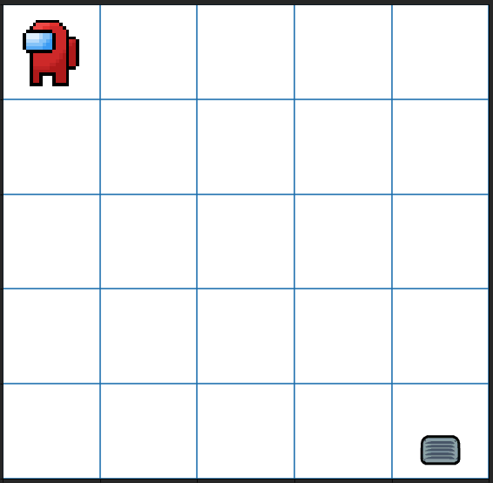
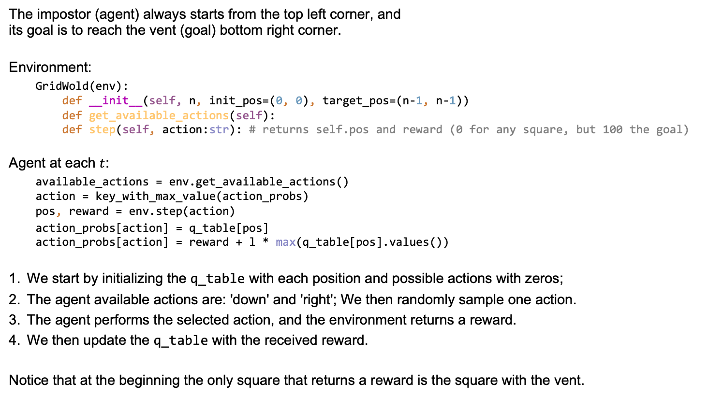
A Grid World Example
The impostor (agent) always starts from the top left corner, and its goal is to reach the vent (goal) bottom right corner.
Environment:
GridWold(env): def __init__(self, n, init_pos=(0, 0), target_pos=(n-1, n-1)) def get_available_actions(self): def step(self, action:str): # returns self.pos and reward (0 for any square, but 100 the goal)
Agent at each $t$:
available_actions = env.get_available_actions() action = key_with_max_value(action_probs) pos, reward = env.step(action)
action_probs[action] = q_table[pos] action_probs[action] = reward + l * max(q_table[pos].values())
We start by initializing the q_table with each position and possible actions with zeros;
The agent available actions are: 'down' and 'right'; We then randomly sample one action.
The agent performs the selected action, and the environment returns a reward.
We then update the q_table with the received reward.
Notice that at the beginning the only square that returns a reward is the square with the vent.

Slide 33
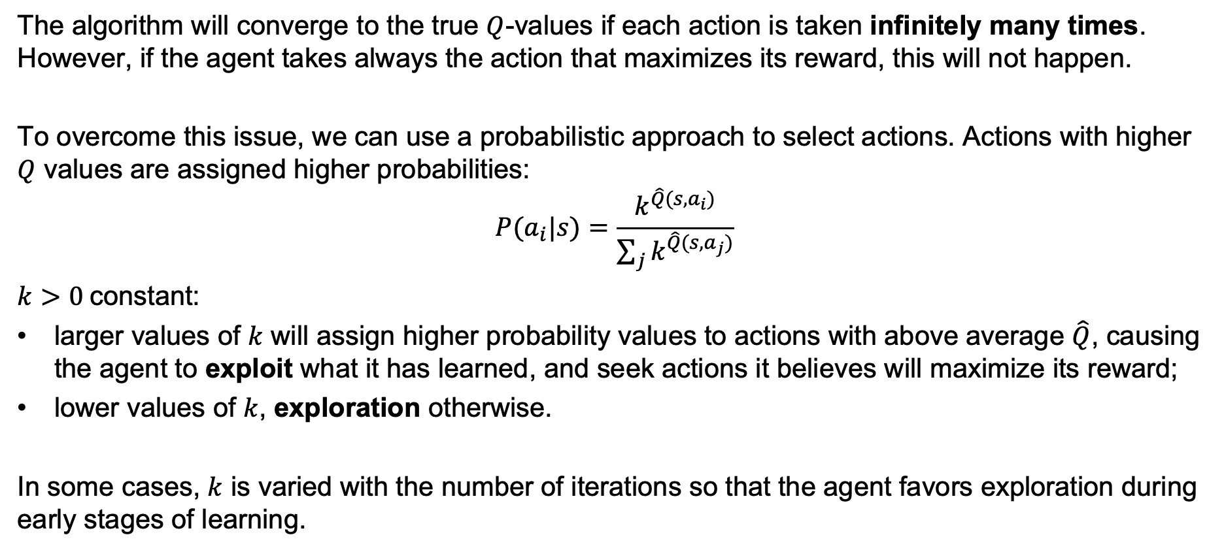
Practical Issues
The algorithm will converge to the true $Q$-values if each action is taken infinitely many times. However, if the agent takes always the action that maximizes its reward, this will not happen.
To overcome this issue, we can use a probabilistic approach to select actions. Actions with higher $Q$ values are assigned higher probabilities:
$$P(a_{i}|s)=\frac{k^{\hat{Q}(s,a_{i})}}{\sum_{j}{k^{\hat{Q}(s,a_{j})}}}$$
$k>0$constant:
larger values of $k$ will assign higher probability values to actions with above average $\hat{Q}$, causing the agent to exploit what it has learned, and seek actions it believes will maximize its reward;
lower values of $k$, exploration otherwise.
In some cases, $k$ is varied with the number of iterations so that the agent favors exploration during early stages of learning.

Slide 34
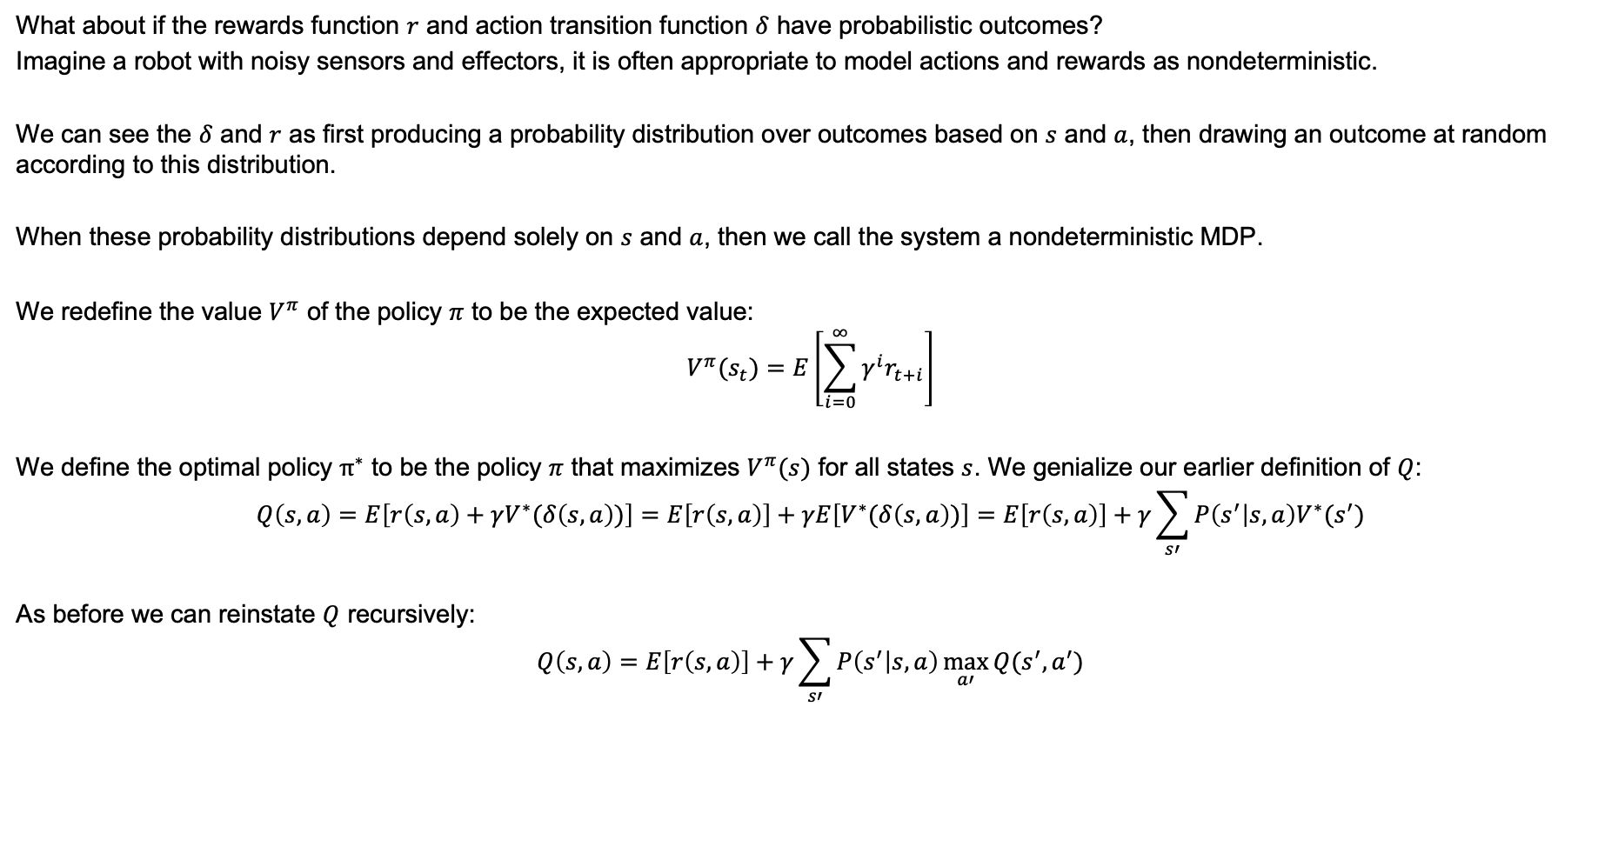
Nondeterministic Rewards and Actions
What about if the rewards function $r$ and action transition function $δ$ have probabilistic outcomes?
Imagine a robot with noisy sensors and effectors, it is often appropriate to model actions and rewards as nondeterministic.
We can see the $δ$ and $r$ as first producing a probability distribution over outcomes based on $s$ and $a$, then drawing an outcome at random according to this distribution.
When these probability distributions depend solely on $s$ and $a$, then we call the system a nondeterministic MDP.
We redefine the value $V^{π}$ of the policy $π$ to be the expected value:
$$V^{π}(s_{t})=E\left[\sum_{i=0}^{∞}{γ^{i}r_{t+i}}\right]$$
We define the optimal policy $π^{∗}$ to be the policy $π$ that maximizes $V^{π}(s)$ for all states $s$. We genialize our earlier definition of $Q$:
$$Q\left(s,a\right)=E\left[r\left(s,a\right)+γV^{∗}(δ\left(s,a\right))\right]=E\left[r\left(s,a\right)\right]+γE\left[V^{∗}(δ\left(s,a\right))\right]=E\left[r\left(s,a\right)\right]+γ\sum_{s′}{P\left(s^{′} | s,a\right)V^{∗}(s^{′})}$$
As before we can reinstate $Q$ recursively:
$$Q\left(s,a\right)=E\left[r\left(s,a\right)\right]+γ\sum_{s′}{P\left(s^{′} | s,a\right)\max_{a′}{Q(s^{′},a^{′})}}$$

Slide 35
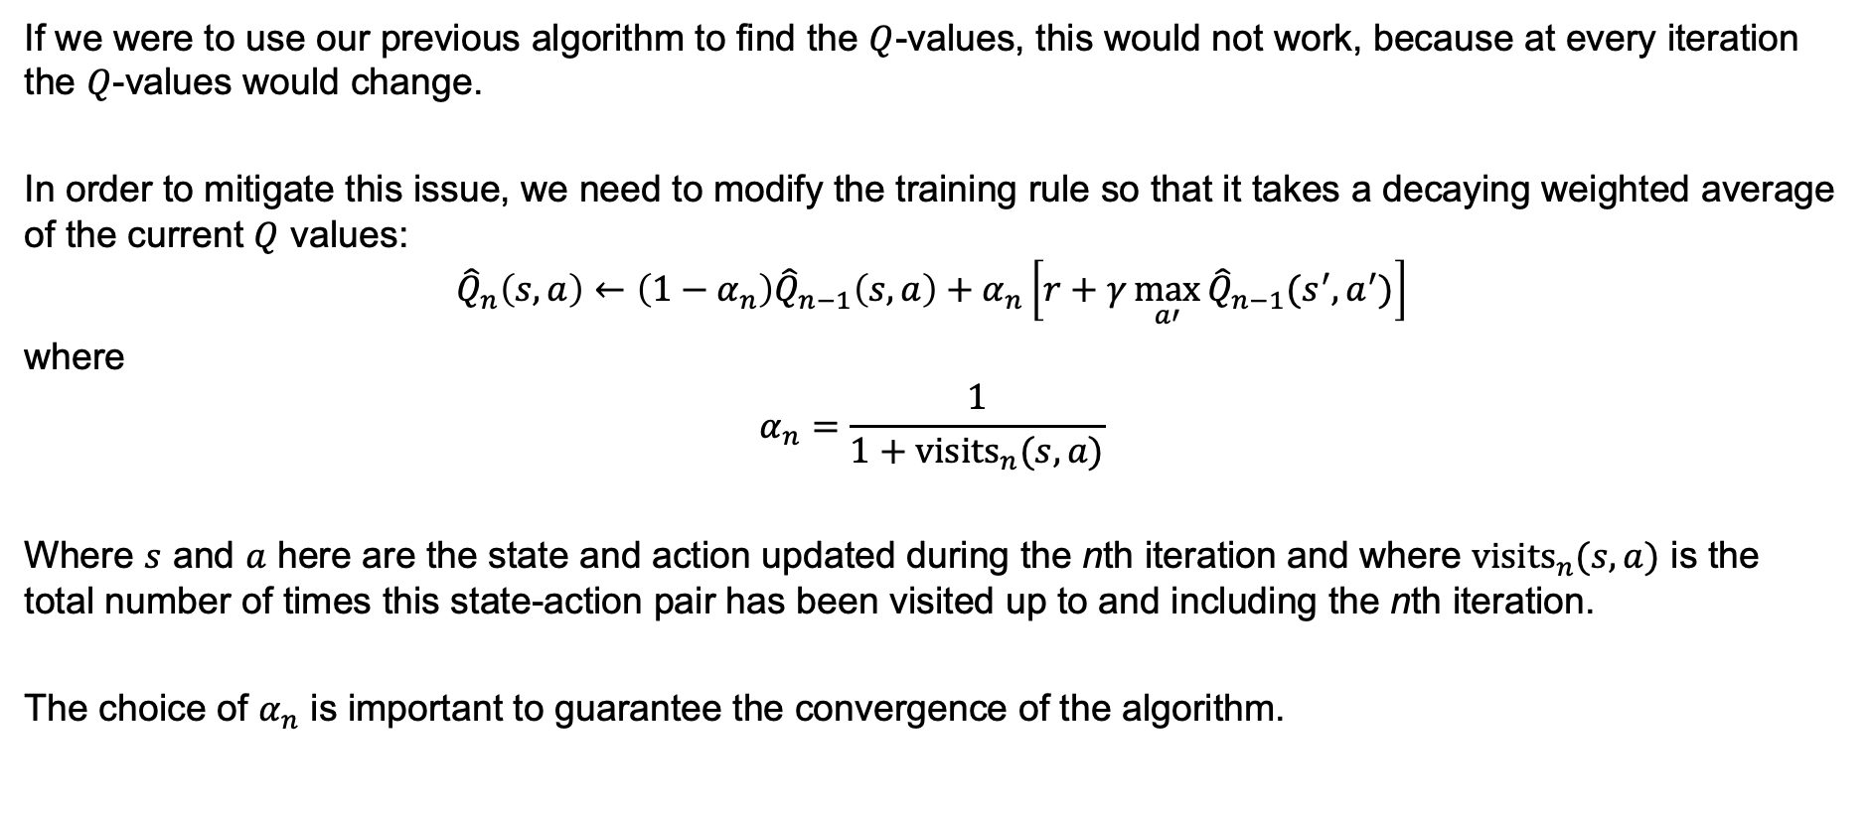
Nondeterministic Rewards and Actions (II)
If we were to use our previous algorithm to find the $Q$-values, this would not work, because at every iteration the $Q$-values would change.
In order to mitigate this issue, we need to modify the training rule so that it takes a decaying weighted average of the current $Q$ values:
$${\hat{Q}}_{n}\left(s,a\right)←\left(1−α_{n}\right){\hat{Q}}_{n−1}\left(s,a\right)+α_{n}\left[r+γ\max_{a′}{{\hat{Q}}_{n−1}(s^{′},a^{′})}\right]$$
where
$$α_{n}=\frac{1}{1+{visits}_{n}(s,a)}$$
Where $s$ and $a$ here are the state and action updated during the nth iteration and where ${visits}_{n}(s,a)$ is the total number of times this state-action pair has been visited up to and including the nth iteration.
The choice of $α_{n}$ is important to guarantee the convergence of the algorithm.

Slide 36
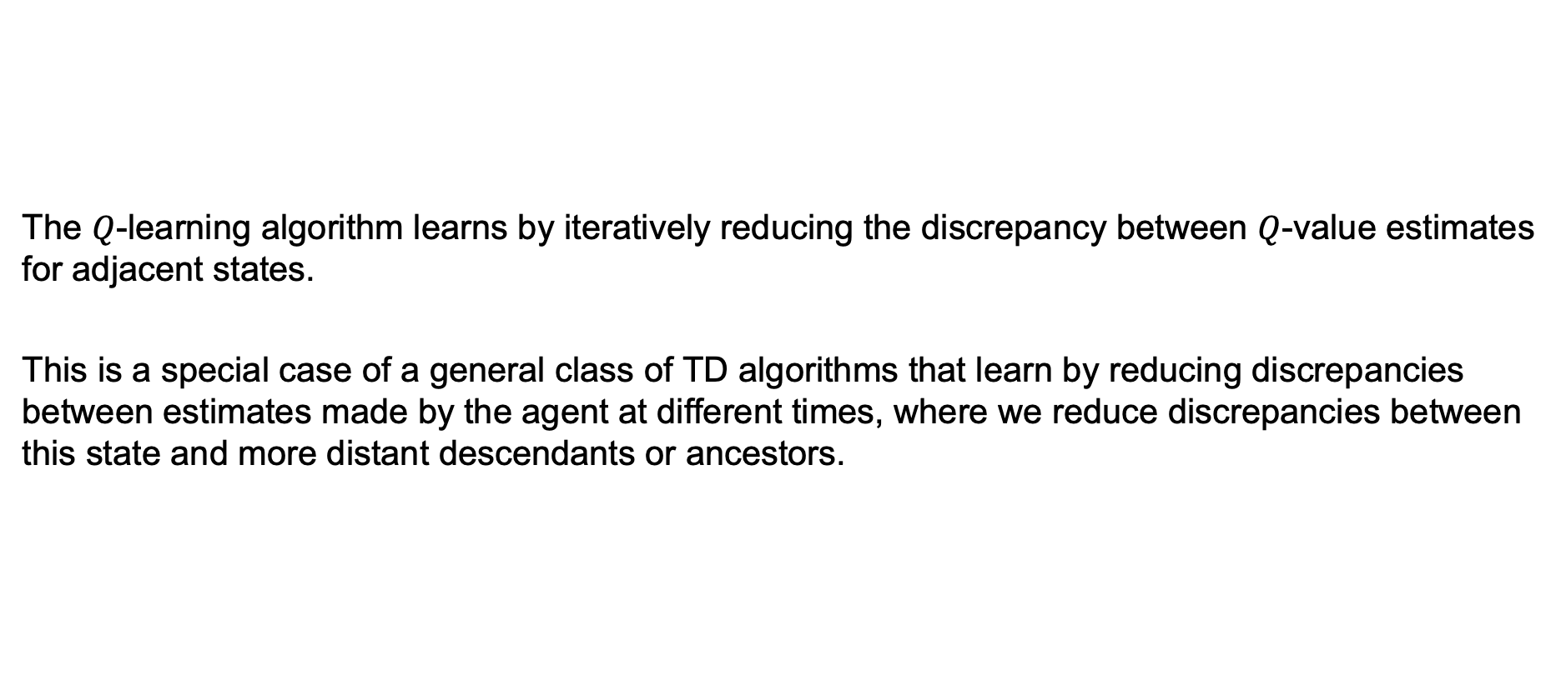
Temporal Difference Learning
The $Q$-learning algorithm learns by iteratively reducing the discrepancy between $Q$-value estimates for adjacent states.
This is a special case of a general class of TD algorithms that learn by reducing discrepancies between estimates made by the agent at different times, where we reduce discrepancies between this state and more distant descendants or ancestors.

Slide 37
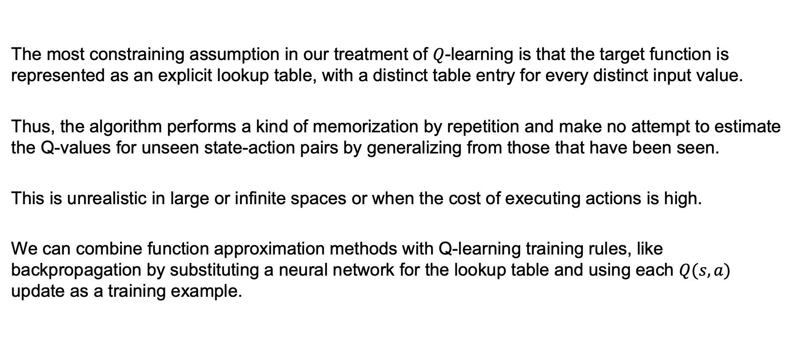
Generalizing From Examples
The most constraining assumption in our treatment of $Q$-learning is that the target function is represented as an explicit lookup table, with a distinct table entry for every distinct input value.
Thus, the algorithm performs a kind of memorization by repetition and make no attempt to estimate the Q-values for unseen state-action pairs by generalizing from those that have been seen.
This is unrealistic in large or infinite spaces or when the cost of executing actions is high.
We can combine function approximation methods with Q-learning training rules, like backpropagation by substituting a neural network for the lookup table and using each $Q(s,a)$ update as a training example.

Slide 38
Summary
RL addresses the problem of learning control strategies for autonomous agents.
It assumes that training information is available in the form of real-valued reward signals given for each state-action transition.
We worked with problems that fit MDP where the outcome depends only on this action and state.
If we know the state transition and reward functions, we can use Dynamic Programming to solve the value function.
Q-learning is one form of RL in which the agent learns an evolution function over states and actions.

